Slide 1
Second Generation of the EU Asylum acquis Seminar „Provision of legal aid to asylum-seekers in the Republic of Latvia”
09 March 2015, Riga
Andrei Arjupin, Legal Officer
UNHCR Regional Representation for Northern Europe

Slide 2
Legal basis for EU asylum policy:
Treaty of Amsterdam (TEC) (1)
Entered into force 1999
Established an area of “freedom, security and justice”
Legal competence for Justice & Home Affairs – incl. asylum & immigration - moved from national to EU competence
European Parliament: consulted on laws
Asylum no longer regulated at national level - brought within EU legal competence
2
Notes:
2
FSJ: asylum moved to first pillar (Cty competence). Foundation laid for harmonisation process and CEA policy.
Title IV: ‘measures on asylum IN ACCORDANCE WITH THE 1951 CONVENTION’

Slide 3
Treaty of Amsterdam, 1999 (TEC) (2)
Art. 63: basis for Community asylum instruments: ‘The Council.. shall… adopt measures on asylum in accordance with Geneva Convention… and other relevant treaties…’
Legislation setting common minimum standards required for:
Asylum Procedures
Reception
Criteria for refugee/complementary protection (“Qualification”)
Temporary protection
Allocation of responsibility for asylum claims (Dublin Regulation)
Declaration 17 requires ‘consultations (to) be established with UNHCR ..on matters relating to asylum policy’
Notes:
Legal competence for Justice and Home Affairs – including asylum and immigration - moved from third to first pillar
Decln 17: ‘consultations shall be established with UNHCR and other relevant intl organisations on matters relating to asylum policy’.

Slide 4
PHASE II, 2004-9: THE COMMON
EUROPEAN ASYLUM SYSTEM (CEAS)
Hague Programme (2004): “Strengthening freedom, security and justice in the EU”
Aimed to establish CEAS, with:
a common asylum procedure and
a uniform status
for those granted asylum/subsidiary protection,
‘Based on full and inclusive application of the Geneva Convention.. and other relevant treaties’
built on a ‘thorough and complete evaluation’ of first phase legal instruments
4
Notes:
4
- Adopted by Euro Council. also Relex; development.
Asylum under ‘Freedom’*
HAGUE IS COUNTERPART FOR TAMPERE. Constitutional treaty should have been the counterpart for the Amsterdam Treaty… instead must continue to work on previous legal basis.
Other aspects of JHA include: police, borders, customs, judicial cooperation, crime and more
QUESTIONS: 1. What else happened in 2004? (enlargement). 2. what was the effect of enlargement on those countries? 3. what influence/negotiating power did they have over the instruments adopted before their accession?

Slide 5
Common European Asylum System (CEAS)
In March 2013, the European Parliament and Council agreed in principle on the text of recast legislation:
Reception Conditions Directive
Dublin Regulation
Eurodac Regulation
Asylum Procedures Directive
26 June 2013: the package is formally adopted by the Parliament and Council and subsequently entered into force the 20th day following the publication in the Official Journal of the EU, i.e. 20 July 2013.
Member States are bound by the provisions of the recast Regulations. Regarding changes to the Directives, MSs will have two years to enact amendments into their national legislation and practice to reflect the new EU provisions.

Slide 6
Access to asylum procedures
Notes:
Identification, information and effective access

Slide 7
Access to asylum procedures [APD recast]
Current Article 6 split in two:
Article 6: General principles of easy and timely access;
Article 7: Asylum applications on behalf of dependents/ children
New Art. 8: Information at border crossing points/ detention facilities

Slide 8
Key objectives/principles
All access systems must be based on the same basic principles to ensure that procedures are easily and equally accessible irrespective of where in the Union an application is made.
MS preserve discretion with regard to the institutional set-up and organization of access systems
BUT, the CJEU requires procedural rules not to render access to rights guaranteed by EU law impossible or excessively difficult and procedures for accessing rights guaranteed by EU law need to be easily accessible.
Case C-327/02 – 16 Nov. 2004

Slide 9
Specific rules to comply with principles set out by CJEU
Clear deadlines for registration [Art. 6(1)]
Effective opportunity to lodge an application with the competent authority as soon as possible [Art. 6(2)]
Lodging in person/at a designated place should not prejudice the effective opportunity to lodge [Art. 6(3)]
Specific arrangements for guaranteeing access for applicants with special procedural needs & UASC [Recital 29, Art. 6(2), 7(4), Art. 24, Art. 25]

Slide 10
Access to the procedure [ Art. 6]
Making = The act of expressing,
in any way, and to any authority, a
wish to obtain international protection
2) Registration = Written record of
the applicant ‘s statement of intention
3) Lodging = Complete application
allowing to start the examination
Make
Register
Lodge

Slide 11
«Making»
Art. 6(1) & Art. 8(1): Facilitate the «making» through i.a. proactive information and identification obligation, interpretation and training of the relevant authorities to help them to detect «applicants»
Art. 10(1) Schengen Handbook: A person must be considered as an applicant if s/he expresses – in any way – fear of suffering serious harm if returned to country of origin or former habitual residence. In case of doubt - consulting with the determining authority
•The making triggers: The right to remain (Art. 9); Material reception conditions; Obligation to assess special needs (Art. 24 recast APD + Art. 22 recast RCD); Duty to cooperate with the authorities (Art. 13 recast APD)

Slide 12
«Registration» 3 possible scenario:
Applications made to the competent authorities to register: within 3 working days after the making;
Applications made to other authorities “likely to receive applications but not competent to register”: Max 6 working days after the making;
In case of: (i) simultaneous applications made by large number of applicants (ii) because of this, very difficult to respect the 3/6 time limit: Max 10 working days.
BUT, none of the applicant’s rights are contingent upon registration. Registration creates a MS obligation aiming at securing the effectiveness of the making.

Slide 13
«Lodging»
Lodging & Registration may be integrated into the same step. BUT: registration deadlines must be kept; opportunity to lodge must remain effective.
The lodging triggers inter alia:
Time limits to examine the application (Art. 31)
A number of reception rights (e.i. documentation & Information (Art. 6 recast RCD), access to employment (Art. 15 Recast RCD)
Start of the Dublin procedure ( Art. 20(1) Dublin).

Slide 14
Applications made on behalf of dependents or children
Art.7(2): Before consent is requested, a dependent adult must be informed in private of: (i) consequences of lodging and (ii) his/her right to make a separate application
Art.7(3): the right of a minor to make an asylum application is explicitly stipulated
Art.7(4): bodies involved in the return procedures should be able to lodge an application for an unaccompanied minor if they are of the opinion that s/he may be in need of protection.

Slide 15
Information & Counseling [Art. 8]
New provision on facilitating access to procedure at border crossing points and detention facilities
Art. 8(1): a proactive information obligation on MS, when there are indications that persons may wish to apply for asylum [Recital 26]
with arrangements for interpretation to the extent necessary to facilitate access to procedures. [Recital 28]

Slide 16
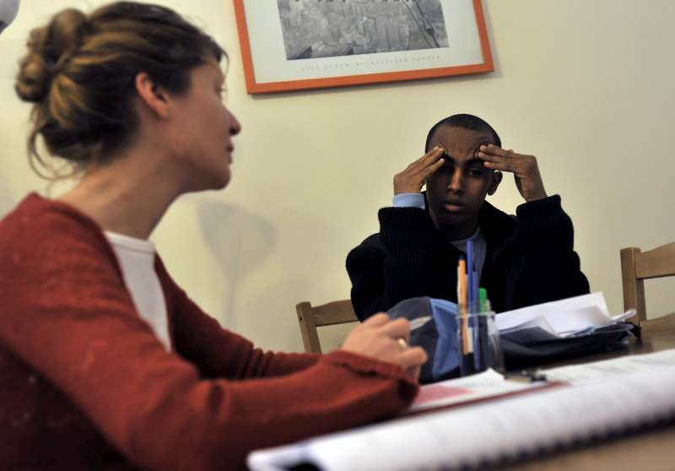
Types of asylum procedures

Slide 17
Types of procedures:
Regular procedure: Art. 31(1-6);
Prioritized procedure: Art 31(7);
Accelerated procedure: Art.31(8 – 9);
Border procedures: Art. 43;
“Admissibility” procedure: Art. 33(2-3)

Slide 18
Prioritized procedure
Art 31(7):
Where the application is likely to be well-founded;
Where the applicant is vulnerable, within the meaning of Article 22 of Directive 2013/33/EU (RCD recast), or is in need of special procedural guarantees, in particular unaccompanied minors.
NB! Prioritized = Accelerated

Slide 19
Accelerated procedure
Art 31(8): 10 exhaustive grounds, incl:
(d) it is likely that, in bad faith, the applicant has destroyed or disposed of an identity or travel document that would have helped establish his or her identity or nationality; or
(f) the applicant has introduced a subsequent application that is not inadmissible in accordance with Article 40(5); or
(h) the applicant entered the territory unlawfully or prolonged his or her stay unlawfully and, without good reason, has either not presented himself or herself to the authorities or not made an asylum application as soon as possible, given the circumstances of his or her entry;

Slide 20
Accelerated procedure
Reasonable time limit for the adoption of decisions as well as complete examination
Reasonable time limit for appeal, Art. 46 (4), also C-69/10 Samba Diouf;
The possibility to ask for suspensive effect of an appeal, Art.46(6)
Is not applicable where no adequate support can be provided to an applicant in need of special procedural guarantees

Slide 21
Inadmissible applications [Art 33]
Dublin case;
Another EU MS has granted international protection;
First country of asylum, Art 35;
Safe third country, Art 38;
Subsequent application, where no new elements presented. [Preliminary examination under Art 40];
A dependent of the applicant lodges an application, and no facts relating to the dependent’s situation which justify a separate application.

Slide 22
Special rules on admissibility interviews [ Art. 34]
Mandatory personal interview on the admissibility of the application before the determining authority takes a decision.
Exception: Art 42 (subsequent applications)
Interview can be done by the personnel of authorities other than the determining authority. BUT! MS shall ensure that such personnel receive the necessary basic training, in particular with respect to international human rights law, the Union asylum acquis and interview techniques.

Slide 23
Subsequent applications
Definition, Art. 2(q):
A further application made after a final decision has been taken on a previous application, incl cases where the applicant has explicitly withdrawn application and cases where the determining authority has rejected an application following its implicit withdrawal in accordance with Art 28(1).

Slide 24
Border procedures
Art 43: Taking decisions at the border or transit zones on:
Admissibility, pursuant to Article 33;
The substance of an application in a procedure pursuant to Article 31(8).
Reasonable time; if no decision within 4 weeks - entry to the territory and channeling into other relevant procedure.
Only the DA can examine the claim and interview the applicant on the substance of the application at the border
NB! Art. 8(3c) on detention & Art. 10(5) of the recast RCD

Slide 25
Free legal information and assistance

Slide 26
Free legal information
Art. 8 APD: Information at border/ detention
Art. 12 APD: Information about rights/ obligations during the procedure
Art. 19 APD: Legal and procedural information free of charge at first instance NB! Subject to conditions - Art 21
Art. 5(1) RCD/ Art 26(2) of the Dublin Regulation: Duty to inform about NGOs that provide specific legal assistance

Slide 27
Free legal assistance
Art 9(6) RCD: In cases of a judicial review of the detention order;
Art 26(2) RCD: for appealing decisions relating to the granting, withdrawal or reduction of benefits, also limitation of the freedom of movement (Art 7);
Art. 20 APD: Free legal assistance and representation in appeals procedures on asylum decisions, incl Art 46(7a);
Art 27(6) of the Dublin Regulation: for appealing transfer to another MS

Slide 28
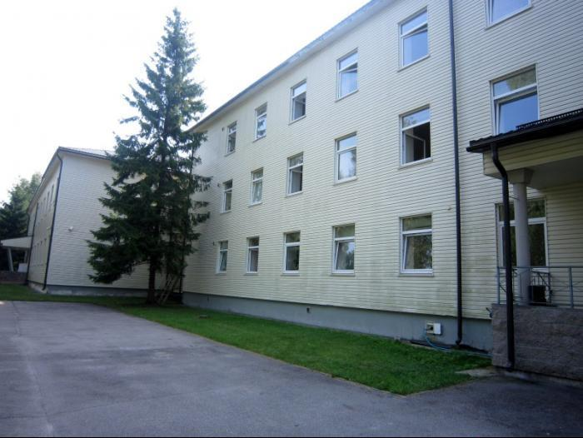
Reception of asylum-seekers

Slide 29
Art 17 RCD recast:
No longer ‘’minimum standards’’, but adequate standard of living, incl. for vulnerable applicants and in detention
Available from point of making the application (Cimade and GISTI)
M.S.S. v. Belgium and Greece: positive obligation to provide accommodation + decent material conditions
Saciri v. Belgium: the amount of the financial aid granted must be sufficient to ensure a standard of living adequate for the health of applicants and capable of ensuring their subsistence guaranteeing the best interests of the child and family unity
Notes:
‘material reception conditions’ means housing, food and clothing, provided in kind, or as financial allowances or in vouchers, and a daily expenses allowance.

Slide 30
Identification of vulnerable applicants with special reception needs (Art. 21-22 RCD)
Art 2k: Definition
Art 21.2 Within a reasonable period after making the application
Art 21.2 Obligation to provide adequate support and address needs if identified later
Art 22.1 Implies requirement that MS systematically assess whether applicants have special reception needs because they are vulnerable
Art 21.3 Only vulnerable persons may be considered to have special reception needs and benefit from the specific support

Slide 31
Link with recast APD
RCD definition:
‘applicant with special reception needs’: means a vulnerable person, in accordance with Article 21, who is in need of special guarantees
APD definition:
‘applicant in need of special procedural guarantees’ means an applicant whose ability to benefit from the rights and comply with the obligations provided for in this Directive is limited due to individual circumstances;
Recital 29 categories mentioned are quite similar.
In RCD a non-exhaustive list (Art 21)
Certain applicants may be in need of special procedural guarantees due, inter alia, to their age, gender, sexual orientation, gender identity, disability, serious illness, mental disorders or as a consequence of torture, rape or other serious forms of psychological, physical or sexual violence. Member States should endeavour to identify applicants in need of special procedural guarantees before a first instance decision is taken. Those applicants should be provided with adequate support, including sufficient time, in order to create the conditions necessary for their effective access to procedures and for presenting the elements needed to substantiate their application for international protection. Applicants with special reception needs may not have special procedural needs and vice versa
Notes:
Certain applicants may be in need of special procedural guarantees due, inter alia, to their age, gender, sexual orientation, gender identity, disability, serious illness, mental disorders or as a consequence of torture, rape or other serious forms of psychological, physical or sexual violence.

Slide 32
Applicants in need of special procedural guarantees (Recital 29 and Art. 24 APD)
Needs to be read in conjunction with Art 24
APD requires MS to ‘’endeavour’’ to identify applicants in need of special procedural guarantees before a first instance decision is taken
They should be provided with adequate support:
sufficient time, in order to create the conditions necessary for their effective access to procedures and for presenting the elements needed to substantiate their claim

Slide 33
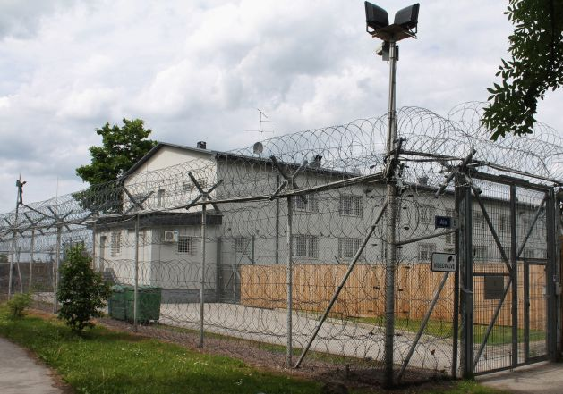
Detention

Slide 34
Receptions Conditions Directive recast: important improvements
Regulates detention of asylum-seekers
Necessity and proportionality test, individual assessment, alternatives first;
List of 6 exhaustive grounds
Right to speedy judicial review of legality;
Appropriate conditions in detention, UNHCR access to detention facilities; limits the use of detention for vulnerable persons + unaccompanied children (UASC)

Slide 35
6 grounds for detention:
a) in order to determine or verify identity or nationality;
b) in order to determine elements of the claim if there is a risk of absconding;
c) in order to decide, in the context of a procedure, on the applicant’s right to enter the territory;
d) NEW: In removal procedures if already detained in which case:
- Burden on MS to substantiate that claim made to frustrate removal + Past opportunity to seek asylum
(e) In the context of Dublin procedures (risk of absconding)
Dublin recital 20 and Article 28 refer to general provisions in the RCD which apply (transfer at the latest w/ i 6 weeks)
Notes:
Arslan (C-534/11):
EU Asylum acquis does not preclude a detention of a third-country national who has applied for asylum after having been detained under the RD, if the asylum application was made solely to delay the enforcement of the return decision and that it is objectively necessary to maintain detention to prevent the absconding.

Slide 36
RCD recast: problematic provisions
Narrow definition of family unity (nuclear family only, only family formed before flight);
Reduction of reception conditions – e.g. if application lodged late and withdrawal in case of subsequent application
Art 8(3c): could create risk of widespread detention in the context of border procedures.
Merits test as a precondition for free legal assistance in the event of reduction or withdrawal of reception conditions, (may run contrary to Article 47 of the EU Charter)
Notes:
Art 47: Right to an effective remedy and to a fair trial

Slide 37
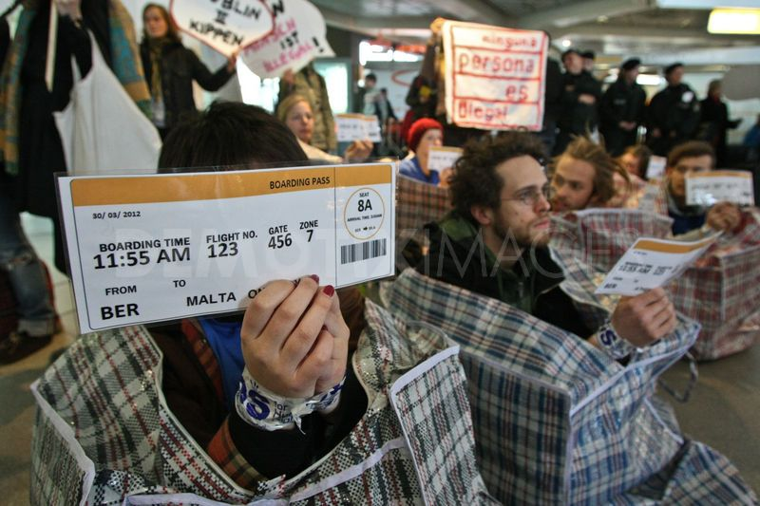
Dublin III Regulation

Slide 38
‘Dublin III’ Regulation 604/2013
Strengthened criteria and procedures:
requirements for more systematic and complete information for applicants and increased procedural safeguards;
interviews in all Dublin cases;
an extended concept of family, increasing scope for relatives beyond the nuclear family to have claims dealt with in the same Member State, and others
More entitlements for unaccompanied/separated children
Wider ‘discretionary clause’ – allowing MS to take responsibility in more cases
Early Warning and Preparedness Mechanism as a means to help detect and avert emerging problems for states’ asylum systems & EASO role (MSS v Belgium/Greece judgment)
38
Notes:
38

Slide 39
Application of Dublin III Regulation to children
MA and Others (C-648/11):
When an applicant for asylum who is an UAM with no member of family legally present in another MS has lodged claims for asylum in more than one MS, the MS responsible for determining the application for asylum pursuant to Article 6(2) of the Dublin II Regulation must, in principle, having regard to the minor’s best interests, and unless those interests require otherwise, be the MS where the most recent application has been lodged (i.e. usually where the UAM is currently physically present).

Slide 40
“Eurodac” Regulation No 603/2013
Access for law enforcement bodies to the fingerprint database
Concerns that data relating to asylum-seekers would be protected from misuse and from the risk of transmission to countries of origin.

Slide 41
PALDIES!
Notes:
41

